Slide 1
What is the Eco Council ?
The Eco council is here to help our school keep its ECO FLAG. We need to look after our planet!

Slide 2
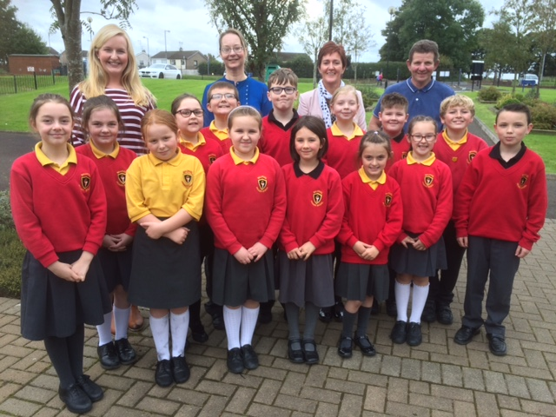
Who is in the Eco Council?
16 Eco Club members (P4 to P7)
16 Eco-monitors from each class (nursery to P7-more on this later!)
2 teachers, Miss Brown and Mrs Allen
Mr McKendry, our school caretaker
Our Principal, Mrs Sheeran

Slide 3
What are our aims this year?
Fighting against LITTER
Saving ENERGY
Being eco friendly with TRANSPORT
If we do all this, we will keep our school ECO FLAG!

Slide 4
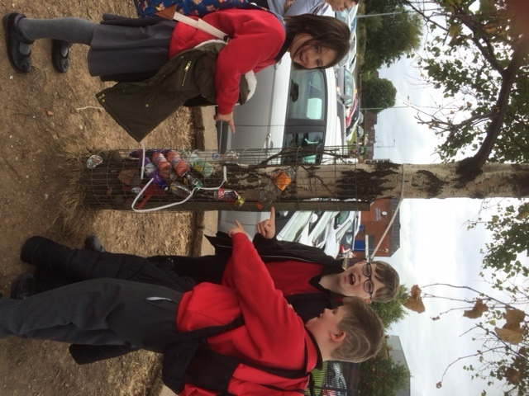
Fighting against LITTER
The Eco club walked around the school and was SHOCKED! We found litter EVERYWHERE.
We picked 118 items of litter in 30 minutes…
At the gates the litter problem is huge, people have even put litter inside the wires protecting the trees.
But the most shocking finding was…THERE ARE NO BINS AT THE GATES!

Slide 5
WE WILL
source a bin for people to use outside the school gates-we will write to the council!
source another bin for us to use at the entrance of the school-we will speak to Mrs Sheeran!
ask EVERYONE to use the bins provided
write an article for the Bugle to inform the whole school of what we are doing
organise a Litter Picking week for all classes to take part in
Fighting Litter -Action plan

Slide 6
Saving Energy
The Eco Council walked around the school on Tuesday 20th September after 3pm…We found:
-2 empty classrooms with lights burning
(we have the teachers’ names!)
-2 toilets left with lights on and no-one in them
-4 lights burning in the empty Assembly Hall
-5 White Boards left on even though no pupils were in the room (names in black book)
Did you know what the school’s electricity bill was in January of this year?
£1,968!
Something needs to be done!

Slide 7
We will:
Ask teachers in each class, from nursery to P7, to choose an Eco-Monitor. The pupil will be responsible for checking that all lights are turned off when no-one is in the class.
Ask all members of the school to help us by turning off lights when they are not needed
Monitor our progress by looking at our school electricity bills. We hope to reduce our next January electricity bill!
Saving Energy Action Plan

Slide 8
Summary
Please choose an Eco monitor for each class and send their names to Mrs Allen
Please turn lights off and do not throw litter on the ground
A litter picking rota will be sent out to you soon!
Please put one of our Eco posters up in your classroom!
THANK YOU VERY MUCH!

