Slide 1
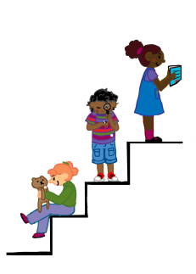
Speech Sounds
Getting Ready to Learn
Supporting Development
COMET Speech and Language Therapist: Mary Woodward

Slide 2
Getting Ready to Learn
To tune in to sound children need:
Good hearing
People around them:
- looking at them when they are talking
- using clear speech
- reducing background noise
Notes:
Keeping a careful watch on hearing is really important.
Children learn speech by listening to those around them, so how you talk is really important.

Slide 3
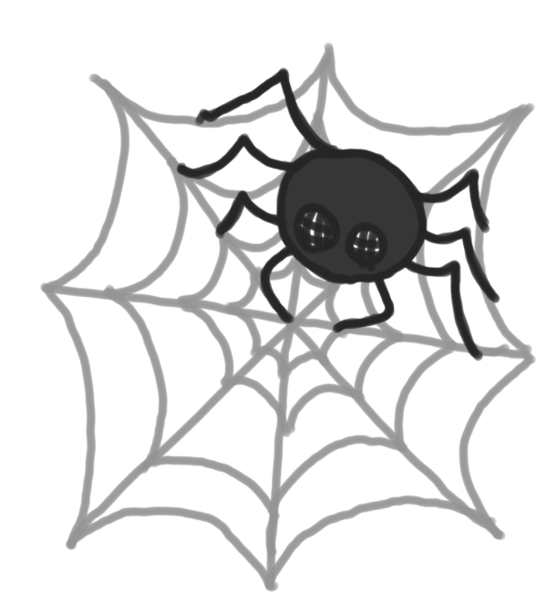
Getting Ready to Learn
It is normal for a preschool child to not say
all sounds correctly yet.
pider
Notes:
Some examples of things children may not yet pronounce correctly e.g.
“pider” for spider
“sop” for shop
“sips” for chips
“wellow” for yellow
“wabbit” for rabbit
These “mistakes” are normal for children aged 3-4 years.
But don’t make the mistake of copying how the child says the word as they must hear words said correctly for their speech to mature.
Just say the word correctly as if you are talking to them about what they are interested in.
This is called modelling.

Slide 4
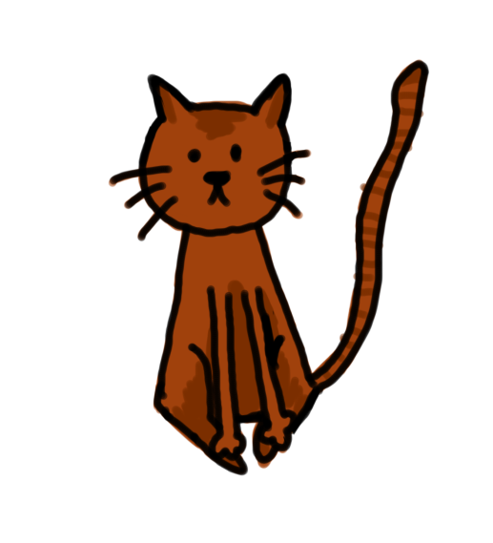
Getting Ready to Learn
Modelling sounds
tat
Yes, it's a cat.
It is a cute cat!
Do you want to stroke the cat?
Notes:
If child says:
'tat' for “cat”
you say cat in a sentence or phrase,
e.g. “yes, it's a cat”…
..try to say it lots of times:
“It’s Granny’s cat…
It’s such a
cute wee cat..
do you want to pet the cat?”
Modelling (you could be Naomi Campbell) is one really important thing you can do to help speech develop
Modelling means saying they word correctly after your child says it BUT NOT AS IF YOU ARE CORRECTING

Slide 5
Getting Ready to Learn
How can I help speech?
Quality interaction
Model sounds
Support:
attention & listening
Memory
phonological awareness

Slide 6
Getting Ready to Learn
Quality interaction:
Have fun
Be face to face
Follow child’s lead
Keep turns going
Notes:
The first step in helping your child’s speech is to have fun together so he’ll want to interact with you. Think about how your face shows you are having fun! SMILE!
By being face to face with your child, you can see what he’s looking at. Then you can talk about his interests, if you talk about what interests him he is much more likely to pay attention and learn from you.
Follow child’s lead: comment on what your child is talking about or interested in. Again he is more likely to listen so then you have the chance to be a good model.
Keep turns going: pause and look at your child expectantly so he can have a turn to talk.
Frequent quality interactions that the child enjoys is the most helpful thing to support speech development.

Slide 7
Getting Ready to Learn
Delayed speech development
If a child is 3 and friends/family/school cannot understand him or he says, for example:
“a” for hat
“ba” for bag
“ta” for tap
Notes:
If you are worried about speech and language development for any reason, come and talk to staff in pre-school or the Health visitor.
You can refer directly to see a speech therapist,
you do not need to ask your GP.
We in can help you.

Slide 8
Getting Ready to Learn
Dummy?
Notes:
By the time your child is in preschool he should not have a dummy at any time!
You need to be cruel to be kind and get rid!

Slide 9
Getting Ready to Learn
Lisps
A lisp is a hissy ‘s’ sound where you can see the tongue protruding between the teeth.
Changing this speech pattern is often not possible until second upper and lower front teeth are in place.
A lisp does not interfere with a child’s educational progress.
It is important that negative attention is not drawn to it.

