Slide 1
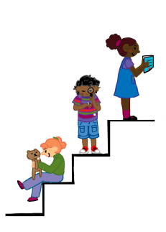
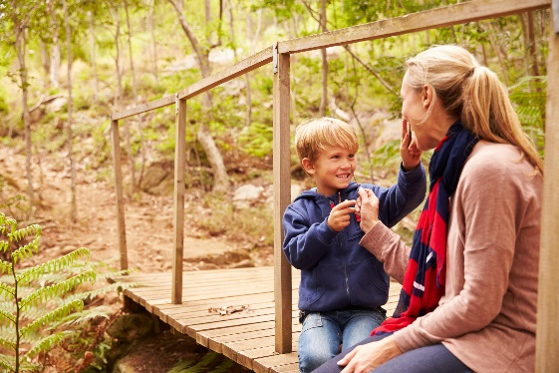
Vocabulary
Getting Ready to Learn
Supporting Development
COMET Speech and Language Therapist: Mary Woodward

Slide 2
Getting Ready to Learn
Vocabulary is:
all the words someone can understand and use.
By 18months old a child will have a vocabulary of about 200 words.
By the time they are 6 years old their vocabulary should be about 14,000 words.
To build vocabulary they need our support.
Notes:
In the preschool years children's vocabulary grows at a fast pace.
By 18months old a child will have a vocabulary of about 200 words.
By the time they are 6 years old their vocabulary should be about 14,000 words.
This means that during this period of their lives they are learning about 8 new words a day.
To do this they need our support.

Slide 3
How can we support?
Getting Ready to Learn
Children learn words by hearing lots of words in interactions where:
the adult talks about what the child is interested in
the adult and child are enjoying each other’s company
the adult and child take back-and-forth turns, keeping the conversation going for as long as possible
Notes:
Children learn words by hearing lots of words in interactions where:
the adult notices what the child is interested in and talks about it
the adult and child are enjoying each other’s company
the adult and child take back-and-forth turns, keeping the conversation going for as long as possible

Slide 4
How can we support?
Getting Ready to Learn
Lots of Reading!
Children learn spoken words as they hear them being read.
Read books, magazines and environmental print.

Slide 5
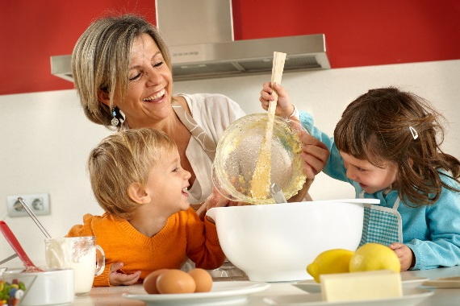
Getting Ready to Learn
How can we support?
Children need to hear a new word many times in context before they start to use it.
Try to create opportunities for
the child to use the word.

Slide 6
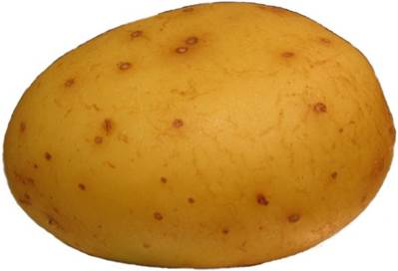
Getting Ready to Learn
How can we support?
You can help a child understand what a new word means by giving lots of clear details about the word and how it connects to the world.
For example, the new word is ‘potato’.
Tell your child:
it’s a vegetable
it’s brown
we eat it (chips, baked, mashed)
it grows in the ground
Clap the syllables in the word
po…..ta….to

Slide 7
Getting Ready to Learn
How can we support?
When introducing a new word, use:
actions
gestures
facial expressions
tone of voice
This helps your child understand the meaning of the word.
I am fff……frightened!
Notes:
When you use actions, gestures, facial expressions and tone of voice along with new words it will helps your child understand the meaning of the word.
For example, if you say the word “frightened” or “terrified” with a shaky voice that sounds like you are scared, it will help your child understand what you mean.

